Slide 1

Utilizing Unstructured Data for Business Intelligence
University of Thessaly
Department of Electrical and Computer Engineering
Diploma Thesis
Author: Petros Lemonopoulos Supervisor: Manolis Vavalis
Volos, July 2020

Slide 2


Contents
Introduction
State of the Art
Data Collection
Data Preprocessing
Text Summarization
Web Data Analysis
Discussion

Slide 3
Introduction(1)
Structured data are insufficient
Data volume is increasing rapidly
Business environment is highly turbulent and influenced by modern information and technology
Most of the data is unstructured (text documents, comments, reviews, likes, images, audio, video)

Slide 4
Introduction(2)
Enterprises is called to face severe challenges in maintaining and expanding their business
Small and Medium Enterprises(SMEs) represent 95% of all businesses
Textual insights is often unmanageable by human

Slide 5
State of the Art
H.P.Luhn 1958 published a paper titled “The automatic creation of literature abstracts”
Experimental research "Automatic summarization of earnings releases: attributes and effects on investors’ judgments".(E. Cardinaels et al., 2019)
“Design of a Small and Medium Enterprise Growth Prediction Model Based on Web Mining”. (Y. F. Te and I. P. Cvijik, 2017)
Paul Hoffman, CTO of Space-Time Insight mentioned “If you want to understand people, especially your customers then you have to be able to possess a strong capability to analyze text “

Slide 6
The aim of thesis
Investigate effective ways to search, acquire and derive non-structured data from various web sources in the context of Business Intelligence for enterprises
Data Collection
Data Preprocessing
Automatic Text Summarization
Web Data Analysis

Slide 7
Data collection
SEC Filings - 10-K Forms
TripAdvisor
Hellenic Chamber of Hotels
YouTube

Slide 8
SEC Filings - 10-K Forms
SEC Filings - 10-K Forms collection from Edgar database
“sec-edgar-downloader” python package
Item 1A - “Risk Factors”
Item 7 - “Management’s Discussion and Analysis of Financial Condition and Results of Operations”
Item 7A - “Quantitative and Qualitative Disclosures about Market Risk”
SEC document as XML Technical specification

Slide 9
TripAdvisor
Serves 463 million travelers each month for their trip
591 restaurants from Thessaly(Larissa, Volos, Trikala, Karditsa)
Python's library BeautifulSoup and urllib2
Name, Location, Street, Cuisine type, Number of Cuisines, Price category, Ranking, Number of Reviews, Total Ratings, Ratings of the four criteria(Food, Service, Value and Atmosphere) and Url of restaurant
Reviews published by customers of restaurants

Slide 10

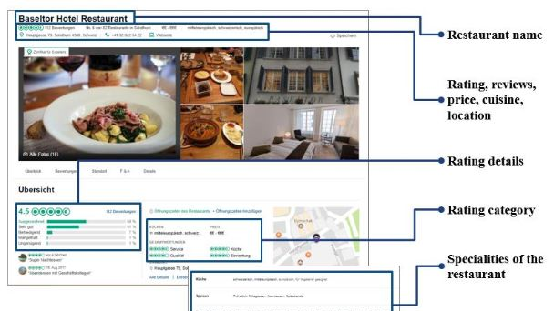



Slide 11
Hellenic Chamber of Hotels
Operates since 1935 as a Legal Entity of Public Law
9.990 hotels from all Greek regions
Python's library BeautifulSoup and urllib2
Name, Distance from hospital, Stars of hotel, Website Url, E-mail, Phone number, Phone number 2, Alternate phone number, Community, City, Address and Zip Code

Slide 12
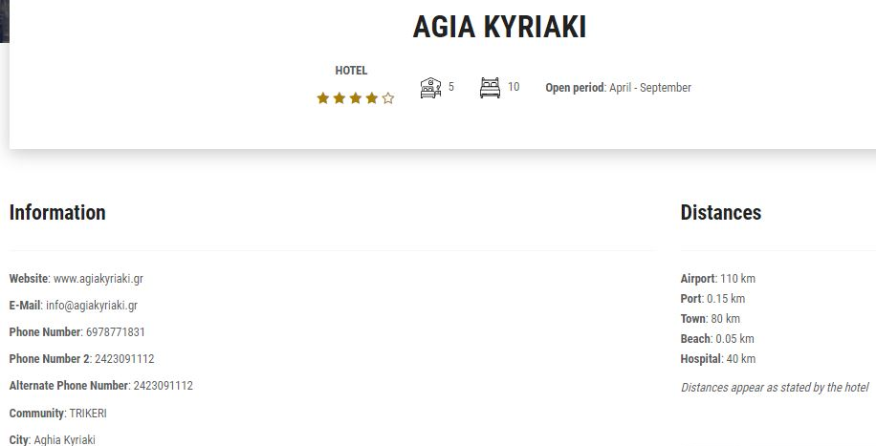

Slide 13
YouTube
Source of knowledge and public opinion
Massive source of unstructured data(video, audio and text)
Script API based on the official YouΤube API
YouΤube video’s search identifier based on popularity
We collect the comments and save them into a file
Number of replies, likes and the title of the video where the comment came from

Slide 14
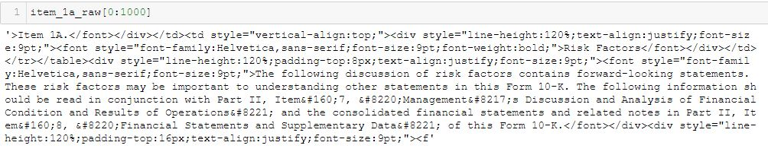
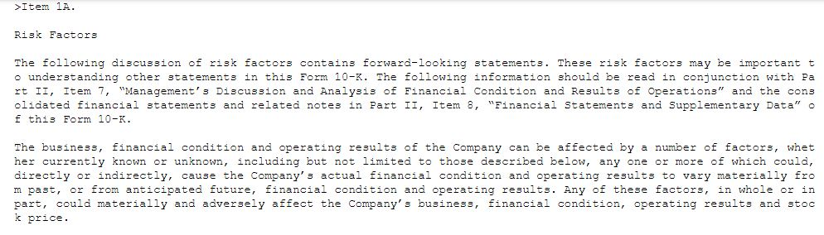
Data Preprocessing

Slide 15
Natural Language Preprocessing(NLP)
Natural Language Toolkit (NLTK) library
Tokenization
Stemming
Lemmatization
Stop Words

Slide 16
Text Summarization
Abstractive summarization
Extractive summarization

Slide 17
Text Summarization algorithms
Luhns Heuristic Method
SumBasic
Latent Semantic Analysis
KLSum (Kullback-Lieber (KL) Sum algorithm)
Edmundson Heuristic
LexRank
TextRank

Slide 18
Conclusions about text summarization
According to experimental research "Automatic summarization of earnings releases: attributes and effects on investors’ judgments".(E. Cardinaels et al., 2019) LexRank technique constitutes the most remarkable algorithm in relation to the other algorithms
LexRank produces summaries that are consistently rated as equal or superior to management summaries
Less bias

Slide 19
Web Data Analysis
Data Visualizations
Sentiment Analysis
Word frequency analysis

Slide 20
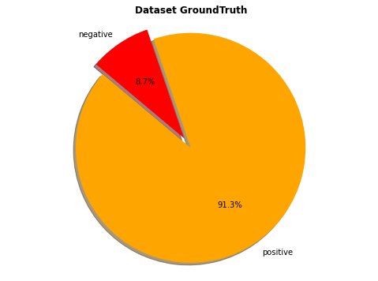
Sentiment Analysis
Supervised learning methods: (a) Logistic Regression and (b) Decision Trees
Features from Bag-of-Words and TF-IDF
F1-Score

Slide 21
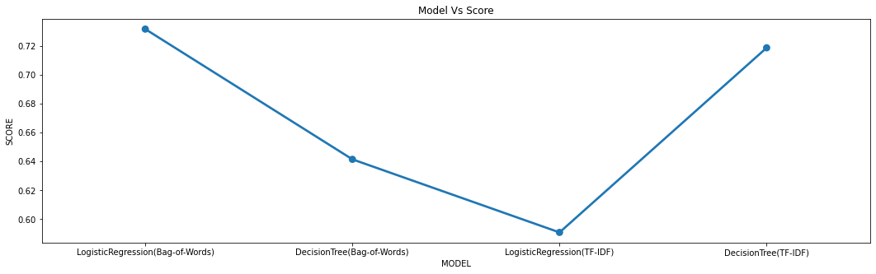

Supervised learning methods

Slide 22
Vader sentiment analysis
VADER (Valence Aware Dictionary and sEntiment Reasoner)
Lexicon and rule-based sentiment analysis tool
Compound score is a metric that calculates the sum of all the lexicon ratings which have been normalized between -1(most extreme negative) and +1 (most extreme positive)
Accuracy 93%

Slide 23
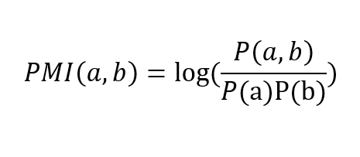
Word Frequency Analysis
Word frequency unigrams and bigrams
Mutual information (MI)
Pointwise Mutual Information (PMI)
PMI calculates (log) probability of coexistence

Slide 24
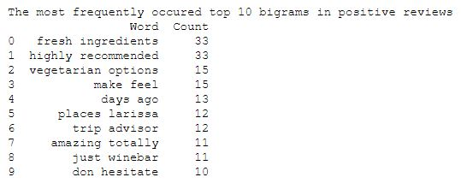
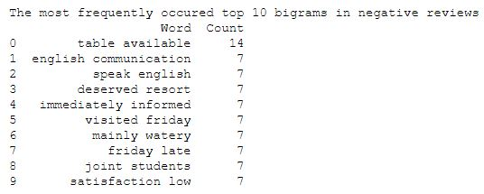
Top 10 bigrams

Slide 25
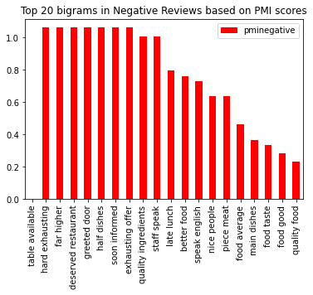
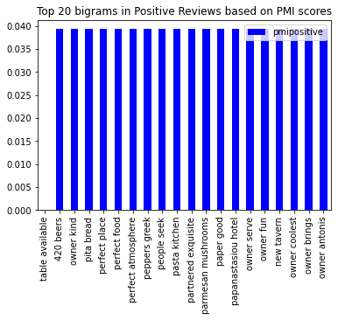
PMI bigrams

Slide 26
Discussion - Synopsis
Harness of various web data sources give us the advantage to cover a wide range of business factors
Business data is constantly increasing
Automatic text summarization is a realistic solution that can give us significant points of business insights
Opinion mining - customer feedback

Slide 27
Limitations and development prospects
Summaries for other types of documents
Abstractive summarization
Other web data sources(Facebook, Twitter, Instagram)
Utilization of financial data of enterprises(growth of revenues, profits and assets etc.)
BI system that could support enterprises

Slide 28
References
The bibliography is contained in our thesis entitled "Utilizing Unstructured Data for Business Intelligence"

Slide 29
Acknowledgements
I would like to thank Professor Manolis Vavalis as well as dear colleagues Christodoulos Pappas and Athanasios Zoumpekas

